Slide 1
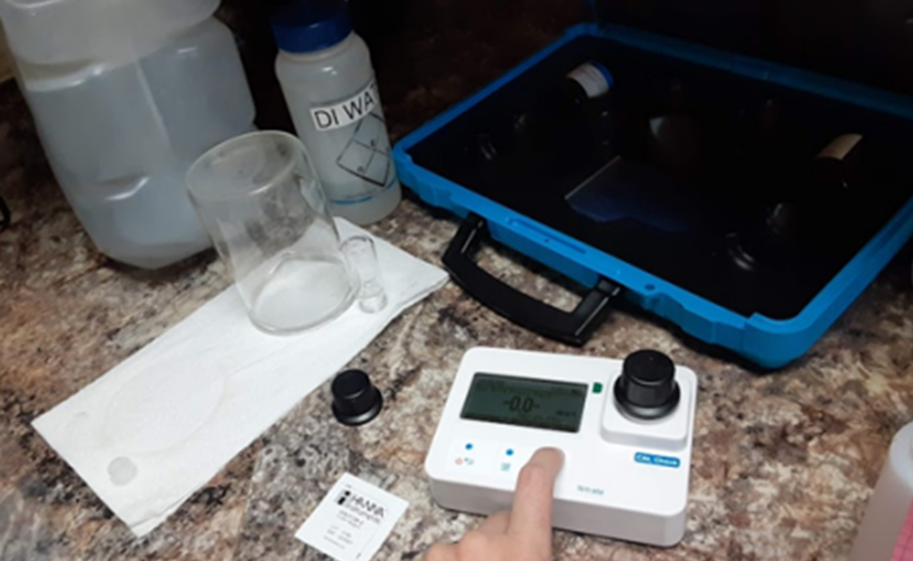
Evaluating Private Well Water Quality in Southwestern Oklahoma
Rayna Ellison¹, Kevin Wagner², and Tyson E. Ochsner³
Rural Scholar, Environmental Science Undergraduate
Director of the Oklahoma Water Resources Center
Professor of Plant and Soil Sciences
Introduction:
Many rural residents depend on private wells for drinking water.
The number of private water wells in Oklahoma is estimated at >145,000 (Weaver et al., 2017).
Water quality for private drinking water wells is not monitored unless by the owner.
However, few well water quality programs available (Ellison, Bode, & Guy, 2022).
The objective is to better understand water quality of private wells in Southwest Oklahoma and to inform rural citizens of their water quality.
Discussions:
Although public water supplies in southwest OK with nitrate concentrations >10 mg/L, all samples from private wells had nitrate concentrations below that threshold and an acceptable pH range 6.5 -8.5.
Total Dissolved Solids (<500) were considered which had a small proportion of samples in the satisfactory range this was not too concerning except for samples in the potential hazard zone as it is not considered a primary pollutant.
The presence of total coliform bacteria (>60% of samples) and E. coli bacteria (>17% of samples) is concerning and requires further investigation.
The next steps of this project would be to conduct sampling over the factors enabling bacteria in the water samples. This would be to determine where the bacteria contamination begin to better understand and help citizens reduce contamination.
Results:
Table 1. County Averaged Results
 | # of Samples | Bacteria | E. Coli | Nitrate | pH | TDS | Salinity
 |  | % positive | % positive | mg/L | - | mg/L | mg/L
EPA Standards |  | n/a | none | 10 | 6.5-8.5 | <500 | n/a
Greer County | 18 | 44% | 6% | 1.4 | 7.5 | 1691 | 1331
Tillman County | 12 | 83% | 25% | 1.2 | 7.5 | 1735 | 1228
Harmon County | 21 | 67% | 24% | 2.8 | 7.1 | 2483 | 1747
Figure 2. Histogram of pH values for water samples from private wells in southwest OK. All samples were within the EPA standards.
Image 1. Nitrate meter for water sample testing.
Methods:
1. Work with OSU county extension offices to identify rural residents with private wells interested in water quality testing.
2. Develop flier, press release, and sampling instruction page for each county.
3. Send media to the educators to distribute to their community.
4. Screen well water samples for nitrates, E. Coli, pH, electrical conductivity, and total dissolved and compare the results to the EPA water standards.
5. Present results and explanation over the parameters screened.
Figure 3. Histogram of nitrate concentrations for water samples from private wells in southwest OK. All samples were below the EPA maximum contaminant level of 10 mg/L.
Figure 5. Presenting water quality results and recommendations to well owners in Harmon County.
Acknowledgements:
I would like to thank the Greer, Harmon and Tillman Extension staff and residents for their support and participation in my research. As well as a special thanks to the Rural Renewal Initiative, Dr. Kevin Wagner, and the Oklahoma Water Resources Center for providing me with supplies and encouragement for my research.
Figure 4. Histogram of total dissolved solids (TDS) concentration for water samples from private wells in southwest OK. Many samples had high TDS levels indicating poor quality or potential hazard for drinking.

