Slide 1
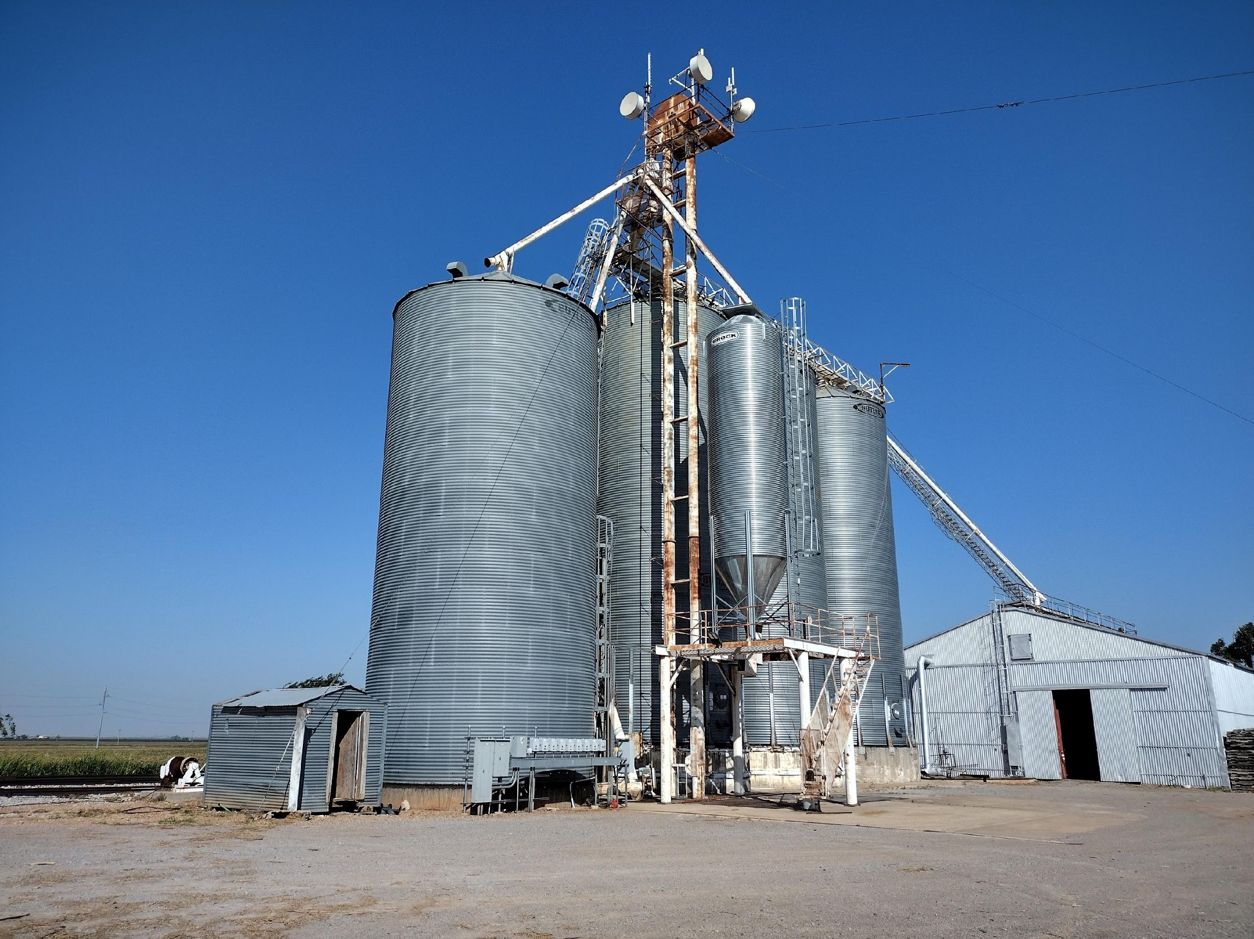
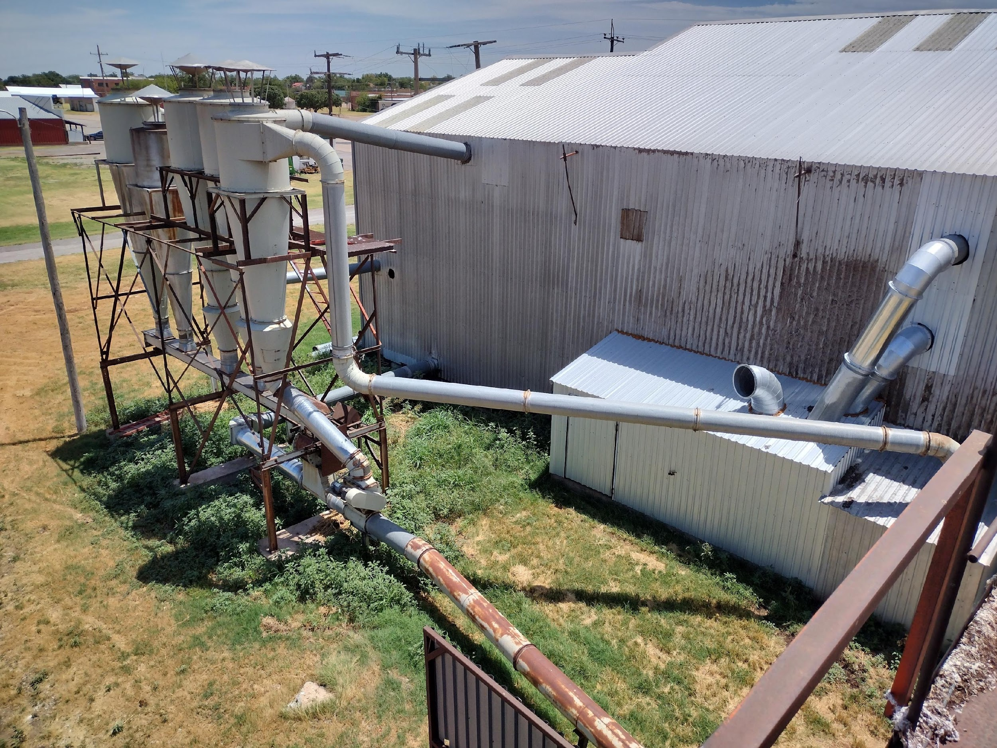
Survey of Agricultural Loads for Renewable Energy Application
Dorian Cathey (OSU Rural Scholar), Moaz Zia (Data Analyst), Dr. Hamid Nazaripouya (Project Advisor), Dr. Scott Frazier (Project Advisor)
Dr. Paul Weckler (Project Advisor), Kerry Rowland (AEP), Jeff Simpson (SWRE), Cindy Conner (OCES), Jim Reese & Anna Politano (OAEC)
Oklahoma State University-Stillwater, School of Electrical and Computer Engineering
Abstract
Data Collection
Data Analysis
Rural communities in the US have been seeking sustainable alternatives to their power and energy consumption.
During Summer 2022, surveys were done in Tillman County and Kiowa County, OK to assess electrical loading of various agricultural businesses.
Electrical meter data was collected to develop a load model for analyzing different temporal environmental factors and trends.
This comprehensive data can be used to analyze agricultural load profile patterns and potentially explore optimum integration of renewable energy resources to supply them.
In-person electrical surveys took place at different agricultural sites such as cattle ranches, cotton gins, grain elevators, feed mills, and center pivot irrigation.
Data collection took place in Southwest Oklahoma during June and July 2022. Each survey took approximately 3-4 hours and recorded the following:
Business type and description
Utility data from electrical meter(s) on the property
Inventory of major electrical users (loads)
Motors, HVAC, Pumps, Lighting, et cetera
Operating time schedule
Center pivots play a direct role in the irrigation of crops hence its electrical load has some meteorological dependencies like rainfall and temperature.
Center pivots are operated to their maximum capacity during the planting season.
Grain and cotton elevators process the crops for storage, so their electrical load is directly related to the harvest season. So, there is a temporal component, associated with their load compared to center pivots.
Parameter | Pearson Correlation Coefficient
 | Center Pivot | Grain Elevator | Cotton Gin
Hours | -0.005 | 0.529 | 0.459
Days | 0.058 | 0.603 | 0.553
Conclusion
From the analysis, the agricultural loads have temporal dependencies along with some meteorological dependencies like temperature, rainfall, seasons, humidity and irradiation.
Based on these uncertainties, deterministic forecasting is not an accurate option for agricultural load modeling. A probabilistic model should be developed for a more accurate load model.
All these factors somehow needs to be accounted for while doing load modelling.
Monthly Maximum and Minimum Load Profiles
Daily Load Profiles for November 29th, 2022
Center Pivot
Grain Elevator
Cotton Gin

