Slide 1
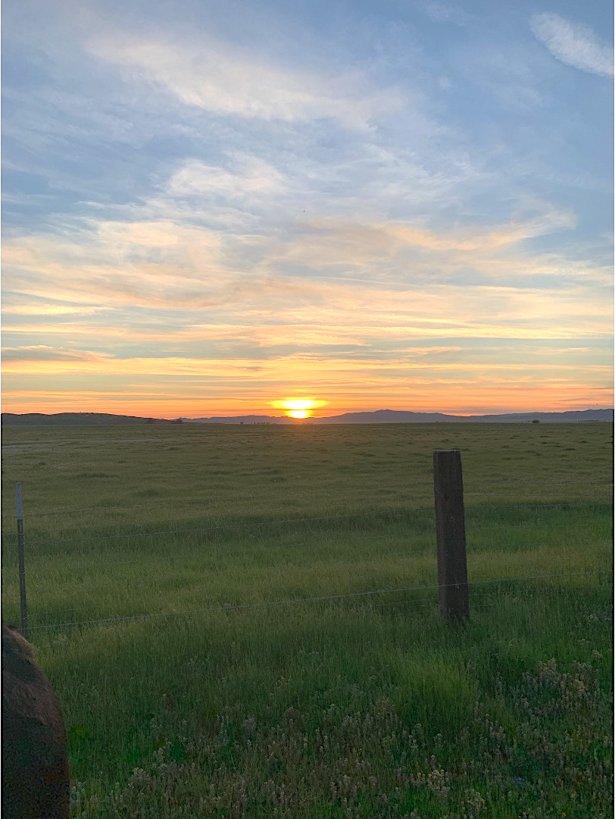
Rewriting the Narrative of Rural Oklahoma
Content Analysis of Media Articles Regarding Rural Oklahoma & A Portrait of Leadership in a Rural Oklahoma Community
Anthony C. Caruso, Audrey E. H. King, & Lauren. Lewis Cline
What is the current narrative of rural Oklahoma as told by the media?
What are the leadership narratives of a rural Oklahoma community?
Results
Relevancy: 53.6% (n=163)
Tone
      Positive: 87(53.4%)
      Negative: 42(25.8%)
      Neutral: 34 (20.9%)
    Year
      2017: 7 (2.3%)
      2018: 25 (8.2%)
      2019: 53(17.4%)
      2020: 82 (27.0%)
      2021: 81 (26.6%)
      2022: 56 (18.4%)
Results
Theme 1: What leadership is needed
  Generational changes
  Contradictory views of Community Involvement
  Internalized narrative of their community
Theme 2: What Leadership Looks Like
  Shared Purpose
  Leader Attributes
  Leader Behaviors
Methods
Factiva database
5-year period
304 articles
Two coders, 9 variables
Three factual
    Date, Headline & Locality of publishing
Cohen’s Kappa measured level of agreement
Analysis included frequencies, descriptive, Chi-squared
Methods
10 Semi-structured interviews
Rural community members
Pseudonyms were assigned
In vivo coding
Conceptual framework: Community Capitals & Adaptive leadership
Conclusions & Recommendations
Most of the community leadership needs can be identified as adaptative challenges,
Changes associated with community culture and values
Shared leadership organically occurs in the community
      Weight of influence and responsibility is not on one person or small group
Many leaders in the community exhibit adaptive leader behaviors,
      Seeing the big picture of community challenges
      Bringing a variety of perspectives to the table, and
      Managing distress during the change process
Social and cultural community capitals are essential for effective leadership
Community groups shared a similar vision for the community
      Paths to achieving the community vision differed
OSU Extension can work with community members to better understand the existing leadership in their communities and promote their leadership
When tackling community challenges, begin to look at the cultural and social aspects to craft a long-term solution, rather than technical, short-term fixes
Variable | Frequency
Cultural Capital | 41 (25.2%)
Human Capital | 85 (52.1%)
Social Capital | 58 (35.6%)
Natural Capital | 33 (20.2%)
Political Capital | 111 (68.1%)
Financial Capital | 102 (62.6%)
Individual Leadership | 55 (33.7%)
Individual Political Leadership | 82 (50.3%)
Group Leadership | 22 (13.5%)
Organizational Leadership | 70 (43.2%)
Government Organization Leadership | 71 (43.6%)
Conclusions & Recommendations
Database does not pull relevant information
Political and financial goings on were more frequently reported on
Individual political leadership is most frequently mentioned
Natural capital is not a concern for media
Non-formal group leadership is underreported by media
Media frames stories positively more often than negatively
Future researchers should specifically examine the capitals and their tone
Refining search terms for accuracy and precision is essential

